Slide 1
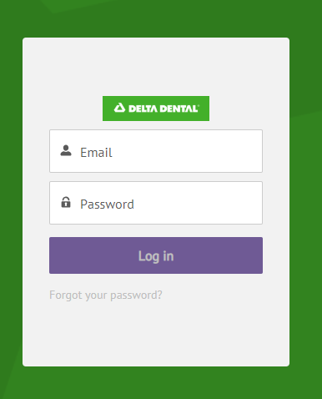
DeltaDentalCoversMyClient.com
Your Guide to Servicing Your Individual Delta Dental Clients
January 2021

Slide 2
DeltaDentalCoversMyClient.com
Thank you for offering Delta Dental of Washington’s plans for individuals and families to your valued clients. We know your clients rely on your services when selecting, enrolling, and renewing in a Delta Dental individual and family plan. That’s why we’ve created this portal that is dedicated to providing you with the information and resources you need to support the needs of your clients for their Delta Dental Individual policy coverage. The portal is secure and can be accessed on mobile devices as well as on your computer. Use Google Chrome as your web browser for best results.
The following slides provide an overview of the portal, the type of information that is available, and how to access important functions.
The Delta Dental team is always available to answer questions and provide additional support. Simply call our Producer Hotline 1-844-335-8275.
2

Slide 3
What Information is Available?
Producer Access to Client Policy Information
Policy Identification Numbers
Renewal Periods
Billing and Payment History
Policy Documents
ID Cards
Declaration Page
Policy Contract
Renewal Documents
3

Slide 4
What Information is Available?
Ability to Service Individual Delta Dental Clients
Process Premium Payments
Update Automatic Premium Payment Methods
Update Client Contact Information
Submit Plan Changes and Terminations
Direct Link to Personal Producer URL
4

Slide 5
Portal Login Page
Logging In to the Policyholder Service Portal
Go to www.DeltaDentalCoversMyClient.com
Enter your login credentials that you received in your welcome e-mail.
If you forget your password, click the “Forgot Your Password” link and a password reset e-mail will be sent to you.
5

Slide 6
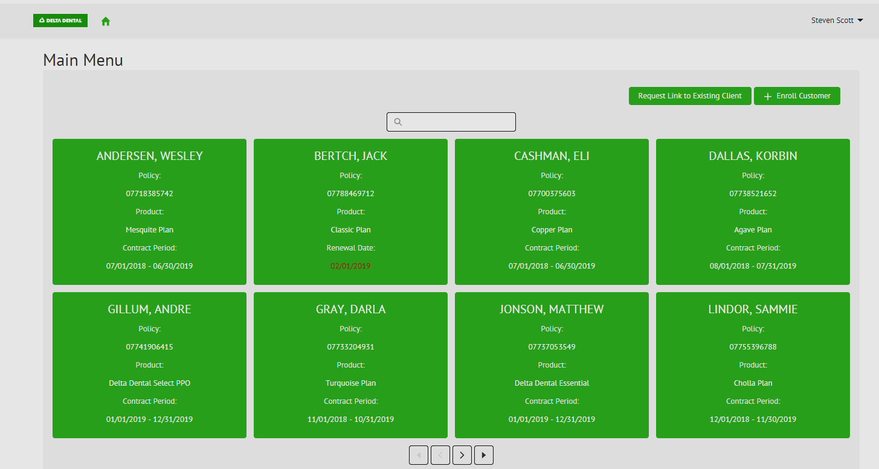
Producer Main Menu
The main menu will provide you with a current client listing, alphabetically by last name. You can also search by client name.
Each linked client will be shown with Policy ID, Policy Name and Contract details.
There is a link “Request Link to Existing Client” which will send an email request to link to your client.
There is also a link “+ Enroll Customer” which will take you to your personal URL for quoting and enrolling new clients.
6

Slide 7
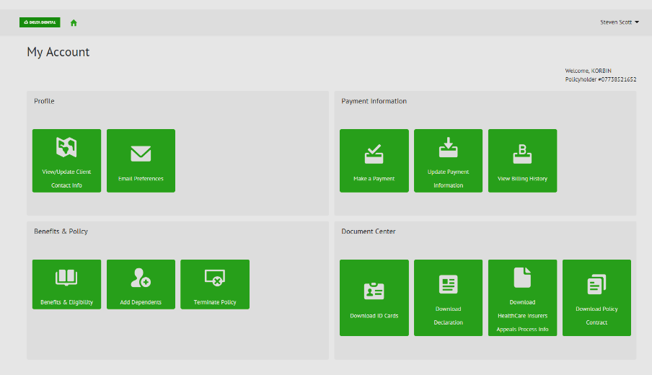
“My Account” Page
After clicking on a specific client, you will be taken to the “My Account” page.
This is where you can view and initiate certain updates and transactions on behalf of your client.
It presents the following four sections:
Profile
Payment Information
Benefits & Policy
Document Center
7

Slide 8
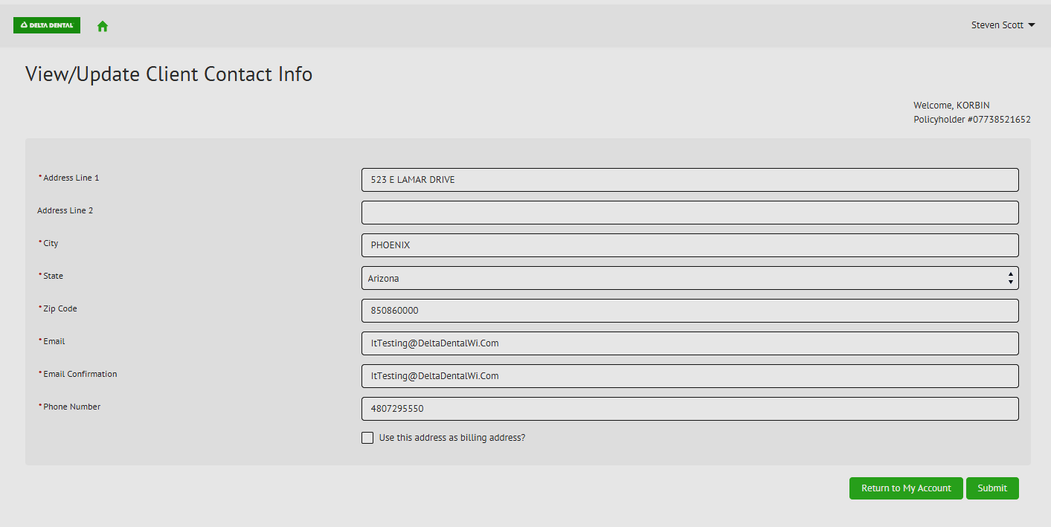
Viewing and Updating Client Contacts
From the “Profile” section of the “My Account” page, you can select “View/Update Client Contact Info”
Here, you can view your client’s current address, e-mail and phone number. You may also update the information if necessary. The changes occur in real time.
8

Slide 9
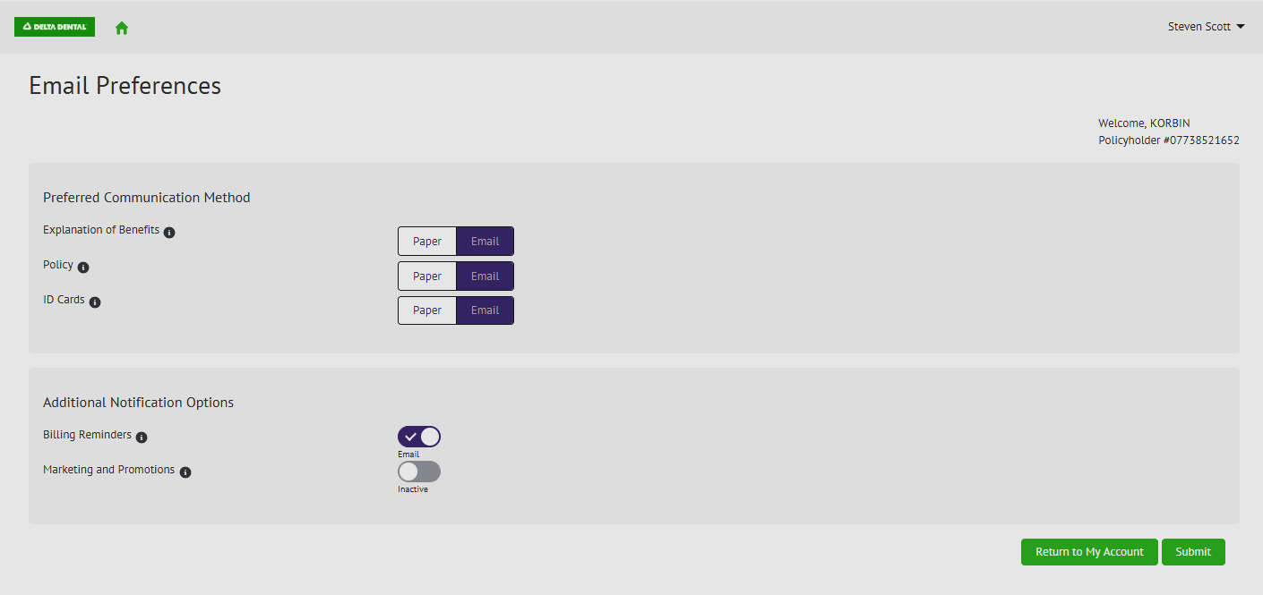
Setting Client E-Mail Preferences
Also from the “Profile” section of the “My Account” page, you can select “E-Mail Preferences.”
The “Email Preferences” section allows the you to update how certain policy information is communicated to your client, such as benefit explanations, policy documents and billing reminders.
9

Slide 10
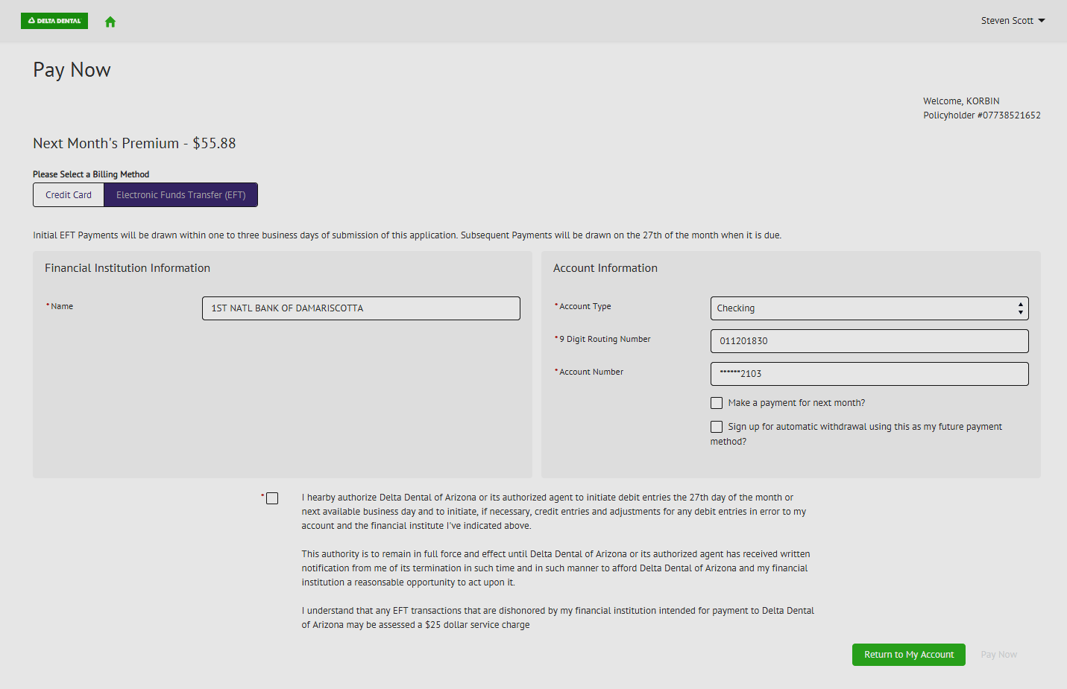
Making Premium Payments
From the “Payment Information” section of the “My Account” page, you can select “Make a Payment”
The “Make a Payment” section allows the you to make a one-time or advanced payment for your client via Electronic Funds Transfer (EFT) or Credit Card. Future payments using EFT or Credit Card are drawn automatically as long as the payment information is current.
The “Pay Now” button at the bottom of the screen must be selected to process the payment. The payment information in this section is the policyholder’s chosen payment information. Current payment information is secured and will not be fully visible to you.
10

Slide 11
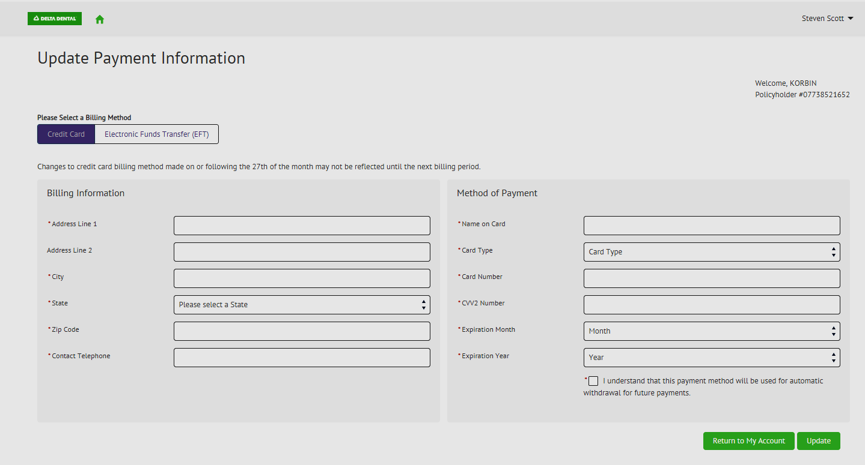
Updating Client Payment Information
From the “Payment Information” section of the “My Account” page, you can select “Update Payment Information”
The “Update Payment Information” section allows you to update your client’s payment method on file for automatic billing. Electronic Funds Transfer or Credit Card can be used for automatic billing, which occurs on the 27th of each month.
The payment information in this section is the policyholder’s chosen payment information. Current payment information is secured and will not be fully visible to you.
11

Slide 12
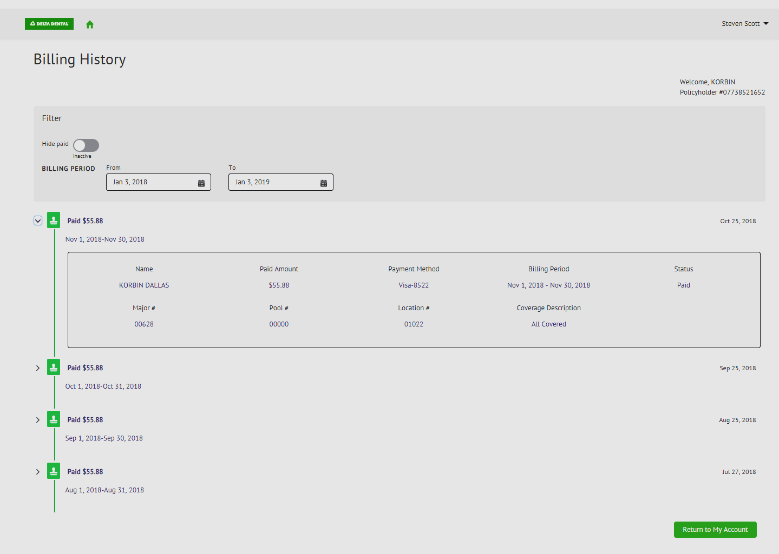
Viewing Client Billing History
From the “Payment Information” section of the “My Account” page, you can select “View Billing History”
The “View Billing History” section will allow you to view your client’s payment history within a specific date period. From this screen, you will be able to view:
The amount of premium paid
The payment method
The date of the payment
12

Slide 13
Viewing Eligibility & Benefit Information
From the “Benefits & Policy” section of the “My Account” page, you can select “Benefits and Eligibility.”
The “Benefits and Eligibility” feature will be added to the portal in a subsequent release. To obtain this information, you can call Customer Service at 1-844-335-8275. Delta Dental representatives are available to answer policy specific questions, such as coverage levels, deductibles and maximums.
13

Slide 14
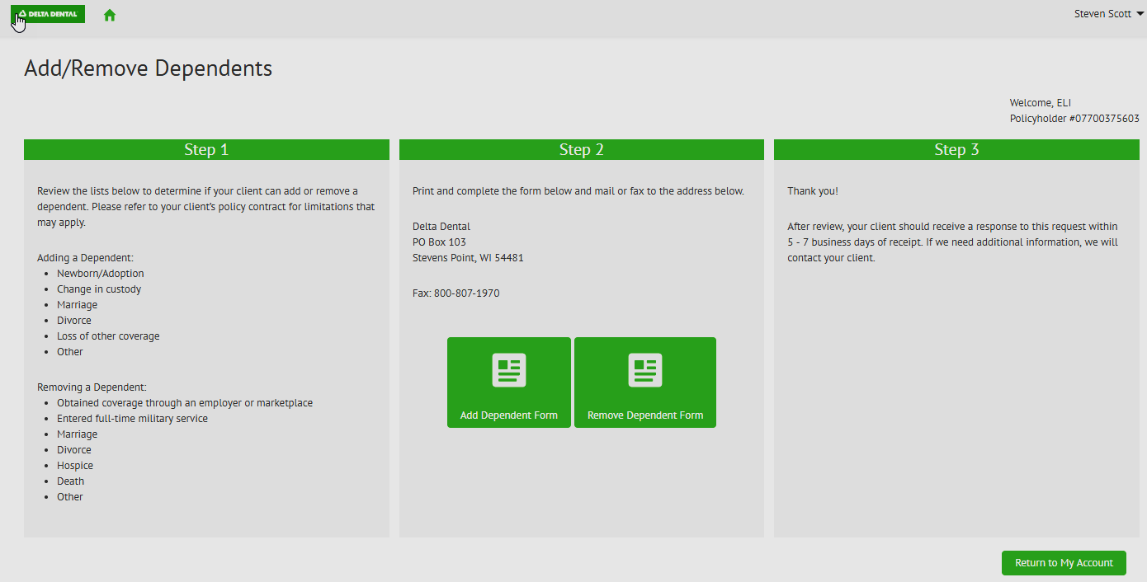
Adding & Removing Dependents
From the “Benefits & Policy” section of the “My Account” page, you can select “Add Dependents.”
The “Add/Remove Dependents” section will provide you with step-by-step instructions to add or remove dependents from your client’s policy.
Specific forms are available to be completed and either mailed or faxed to Delta Dental Customer Service to make the requested coverage changes.
14

Slide 15
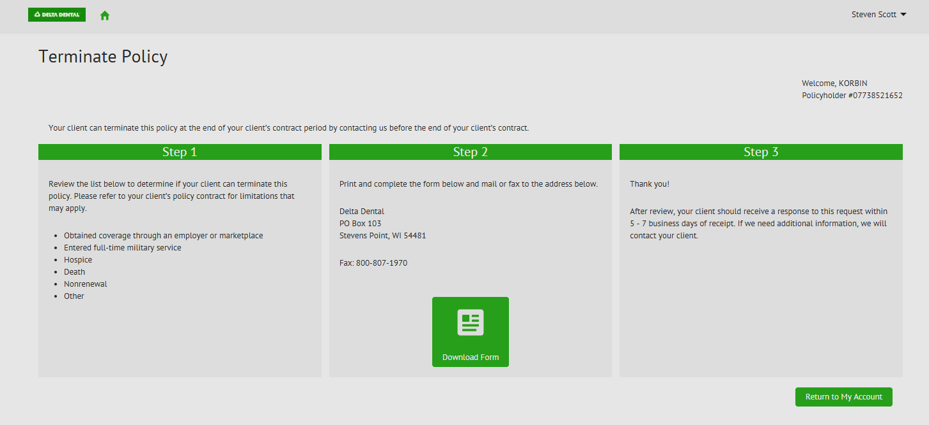
Terminating a Policy
From the “Benefits & Policy” section of the “My Account” page, you can select “Terminate Policy.”
The “Terminate Policy” section provides step-by-step instructions to terminate your client’s policy.
Specific forms are provided to be filled out and either mailed or faxed to Delta Dental Customer Service to process the termination.
15

Slide 16
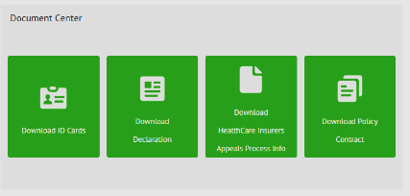
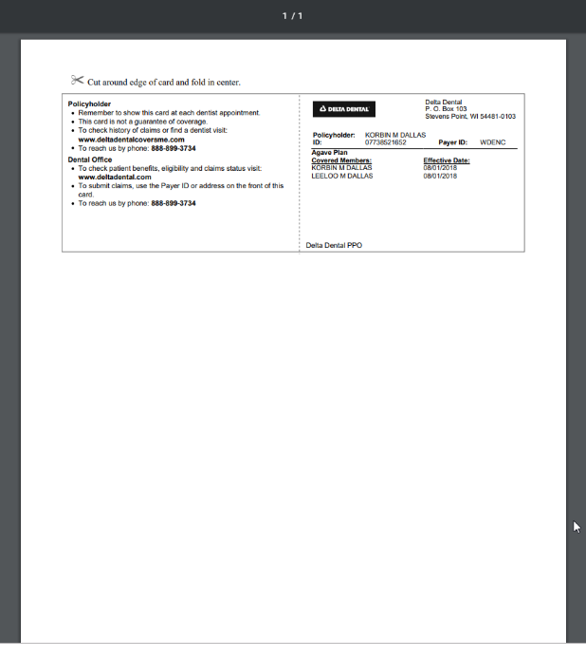
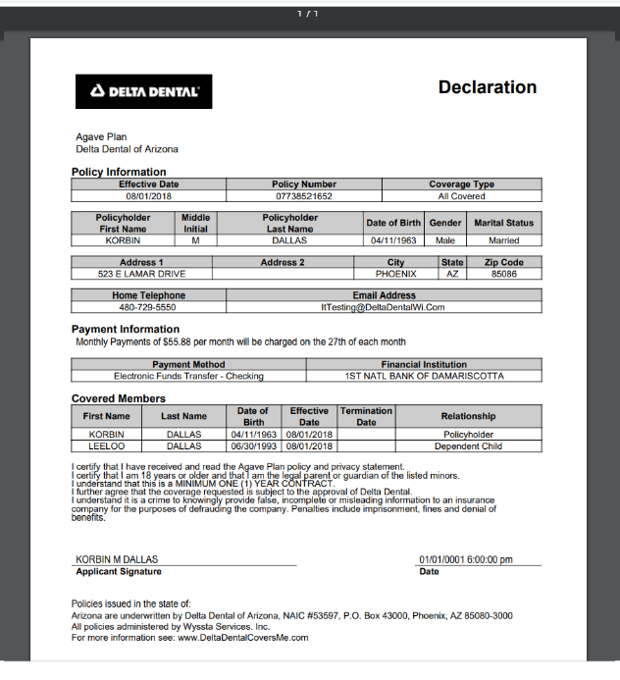
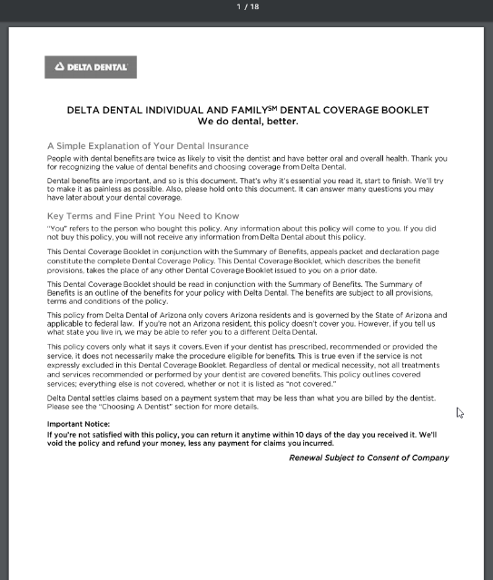
Downloading Documents
From the “Document Center” on the “My Account” page, you can download printable PDF versions of your clients ID card, policy declaration page showing current enrollment information, and the policy which covers your client.
16

Slide 17
Producer Hotline
If you need support, Delta Dental offers a Producer Hotline at 1-844-335-8275
Producer Hotline Representatives can:
Confirm you are linked to a specific client policy
Provide all enrollment and policy information for your client
Answer general policy and coverage questions
Help you in using your unique broker URL for quoting and enrollment
Other contacts
Commission questions: producercommissions@deltadentalwa.com
Licensing questions: producerlicensing@deltadentalwa.com
17

